Slide 1
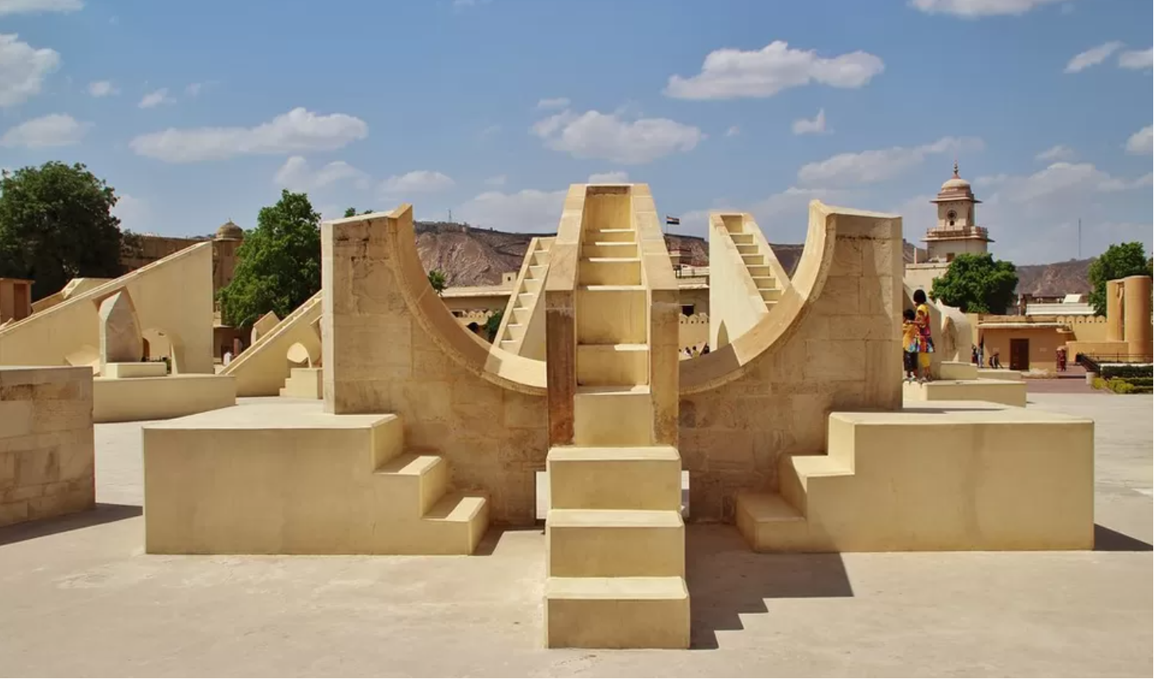
TOURISM PROJECT
TOPIC : - JANTAR MANTAR
RAJASTHAN
PRESENTED BY:- PABITRA
Class :- XII

Slide 2
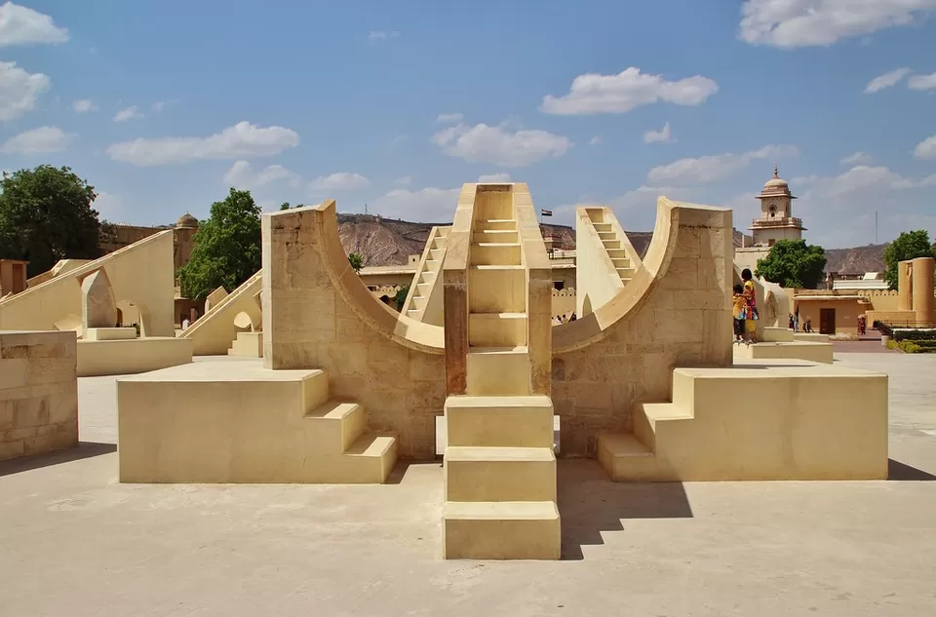
CONTENT
NAME OF THE TOPICS
Location
History
Specialities
Details
Images
Distance From Porbandar
Conclusion and links for more details

Slide 3
LOCATION OF JANTAR MANTAR :-
Jantar Mantar is an 18th-century astronomical observatory located in the heart of Jaipur, Rajasthan
It was built by Maharaja Sawai Jai Singh II between 1728 and 1734 and is a UNESCO World Heritage Site

Slide 4
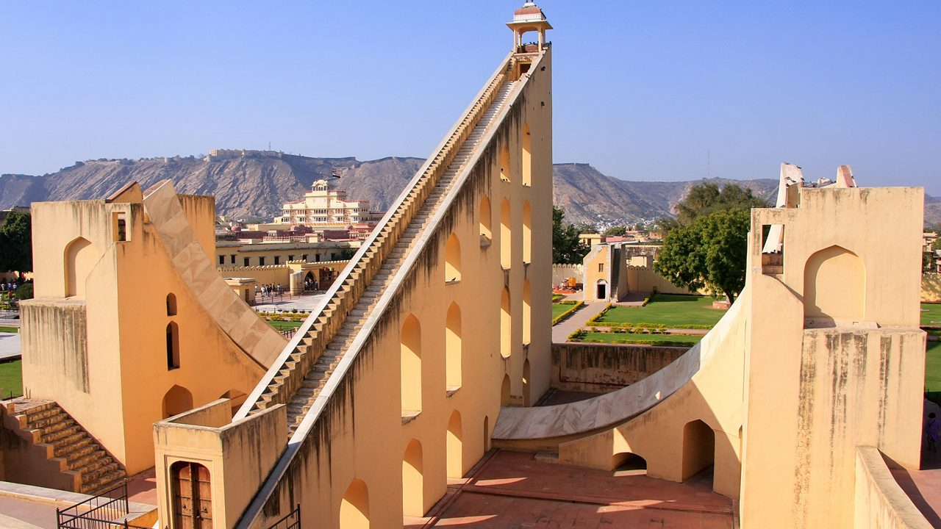
HISTORY OF JANTAR MANTAR
Built between 1728–1734 by Maharaja Sawai Jai Singh II
Constructed to achieve more accurate astronomical observations
Inspired by ancient Indian astronomical texts
Part of a network of five observatories built across India
Reflects advanced 18th-century Indian scientific knowledge

Slide 5
DETAILS OF JANTAR MANTAR
Built by Maharaja Sawai Jai Singh II between 1728–1734.
Located near City Palace, in the heart of Jaipur, Rajasthan.
Comprises 19 large astronomical instruments.
Instruments are made of stone and marble for naked-eye observations.
Designed to measure time, track planets, and predict eclipses.
Home to the Samrat Yantra, the world’s largest stone sundial.
Covers an area of approximately 18,700 square meters.
Declared a UNESCO World Heritage Site in 2010.

Slide 6
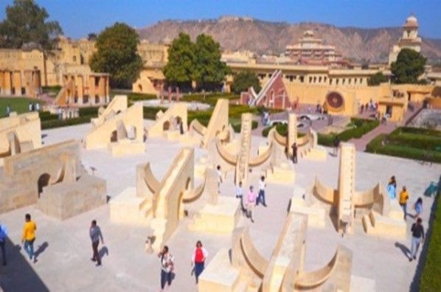

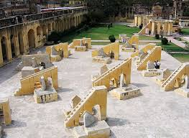
IMAGES OF JANTAR MANTAR

Slide 7

DISTANCE FROM PORBANDER
By Road:
Distance: Approx. 1,055 km
Time: Around 18–20 hours (via NH27)
Route: Porbandar → Rajkot → Udaipur → Kota → Jaipur
By Train:
Distance: Approx. 1,070 km
Time: Around 17–19 hours
Train Options: Porbandar–Delhi Sarai Rohilla Express (stops at Jaipur)
By Air:
Distance (direct line): Approx. 850 km
Time: Around 5–7 hours

Slide 8
Conclusion
Showcases the use of geometry and trigonometry in large-scale instruments
Helped create more accurate astronomical tables (Zij)
Instruments are aligned with cardinal directions for precision
Served as a center for royal scientific research and learning
Influenced the development of later observatories in India
.

Slide 9
THANK YOU

